Slide 1
A ‘superBT’ for TC Operations & Research Mike Fiorino Commander, United States Navy (retired) B.S. (’75 PSU), M.S. (’78 PSU), Ph.D. (’87 NPS) all in Meteorology mfiorino@gmu.edu George Mason University VA AORI University of Tokyo, 柏のは University of Colorado Boulder CO Earth System Research Laboratory, Boulder CO National Hurricane Center, Miami FL Joint Typhoon Warning Center, Pearl Harbor HI Lawrence Livermore National Laboratory, Livermore CA European Centre for Medium-Range Weather Forecasts, Shinfield Park, Berskshire, UK Meteorological Research Institute – Japan Meteorological Agency, Tsukuba JAPAN Space and Naval Warfare Systems Command, Arlington VA NASA Goddard Space Flight Center, Greenbelt MD National Centers for Environmental Prediction, Camp Springs MD Naval Postgraduate School, Monterey CA Fleet Numerical Meteorology and Oceanography Center, Monterey CA Naval Research Laboratory, Monterey CA Atlantic Oceanographic and Meteorological Laboratory, Miami FL Pennsylvania State University, University Park PA

Slide 2
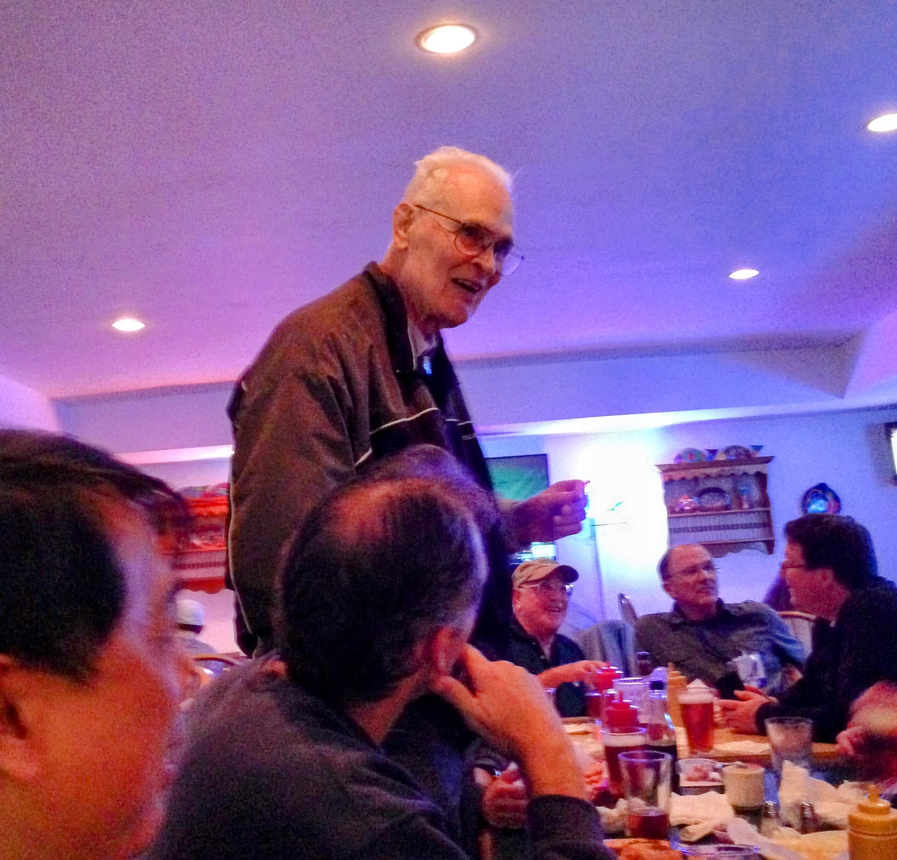
The Bill Gray Standard Seminar Question 20140401 AMS Hurr Conf San Diego
This is all well and good Mike…

Slide 3
The Bill Gray Standard Seminar Question 20140401 AMS Hurr Conf San Diego
This is all well and good Mike…
but why are you doing this?

Slide 4
The Bill Gray Standard Seminar Question 20140401 AMS Hurr Conf San Diego
This work is unfunded…
the real reason…

Slide 5
The Bill Gray Standard Seminar Question 20140401 AMS Hurr Conf San Diego
This work is unfunded…
the real reason…
Alzheimer’s avoidance😉
geeking -- TCs & NWP & computers
毎日日本語を勉強しています – I study Japanese every day to rewire my brain…

Slide 6
Acknowledgements
Jim Kinter, COLA/GMU
sponsors my affiliated faculty position (essentially emeritus) at George Mason U since 2021
Yukari Takayabu-sensei
sponsoring my visiting professorship at U of Tokyo (“TouDai”)
Hans Hersbach, ECMWF
ECMWF computer account and access to ERA5 forecasts
Russ Elsberry (NPS), Rick Anthes & Tom Warner (PSU)
everything I every knew about the science of TCs and modeling I learned at PSU & NPS

Slide 7
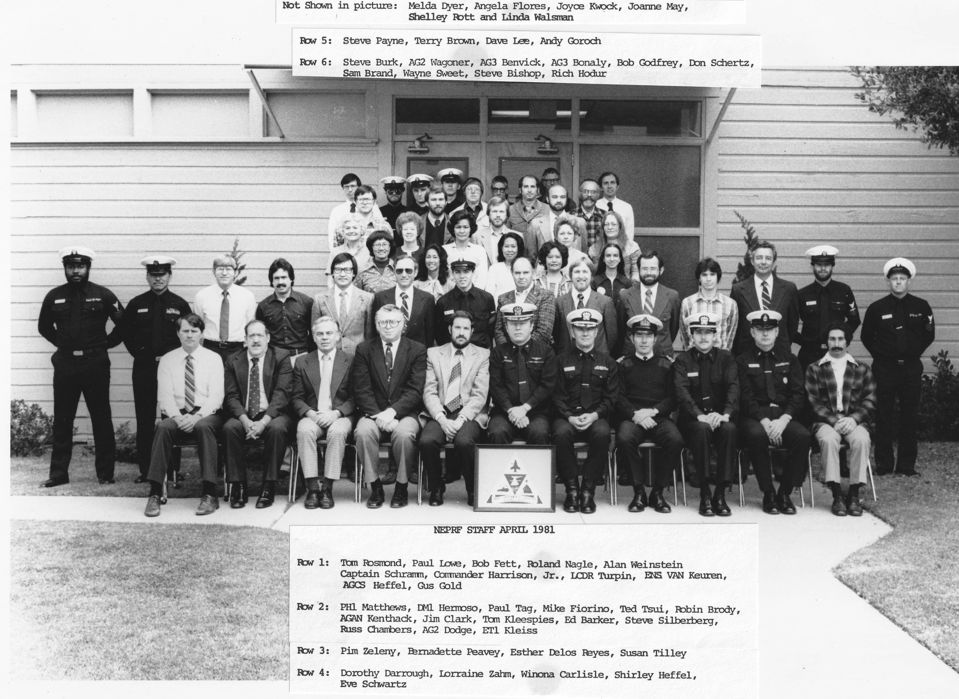

Special Acknowledgement to my
“Sea Daddy” (Mentor)
CAPT Ed Harrison USN (dec)
everything I ever knew about the Navy and TC forecasting…
CDR 1981 XO NEPRF
1st NPS PhD in Meteorology 1973 with Russ Elsberry
one-way influence limited-area model lateral boundary conditions, no bueno, two-way interaction only stable
JTOPS (deputy JTDIR; now XO) 1974-76
Personal – set me on a totally different life path
first .gov full-time job at NEPRF
turned over his NTCM → 1st operational implementation of a baroclinic, two-way interactive moving nested-grid TC model in the USA in 1982
supported my PhD studies with Russ Elsberry
honchoed my1985 USNR commission as an 1805 thru BUPERS → unbelievable Navy Career – especially with JTWC as NWP models Officer & TDO

Slide 8
2024 TCC 40th Anniversary of the Momentous 1984 ATC (and the New Sanno) because of STY ABBY 05W.1983 both personally (no stuff, there I was) and for USN
COMNAVFORJAPAN was P.O.’d to put it mildly …
lost half of his summer training cycles because of the poor JTWC forecasts
after “attention on deck” made the assembled 06s and the rest of us stand at attention for the chewing out … a sight to behold …
blame always flows downhill … as the primary dynamical TC modeler at NEPRF so it was of course my fault
Spectacular ‘failure’ caused a big push ($$) to USN TC research
ABBY track error theory was beta gyres forced a ‘break in the ridge’ because of ABBY’s size
TCM90 – field program to search for the beta gyres…
my PhD research with Russ Elsberry on ‘beta gyres’ 1987
Notes:
Buck talked about the ‘blood bath’ 30 y ago, this was the biggest?

Slide 9
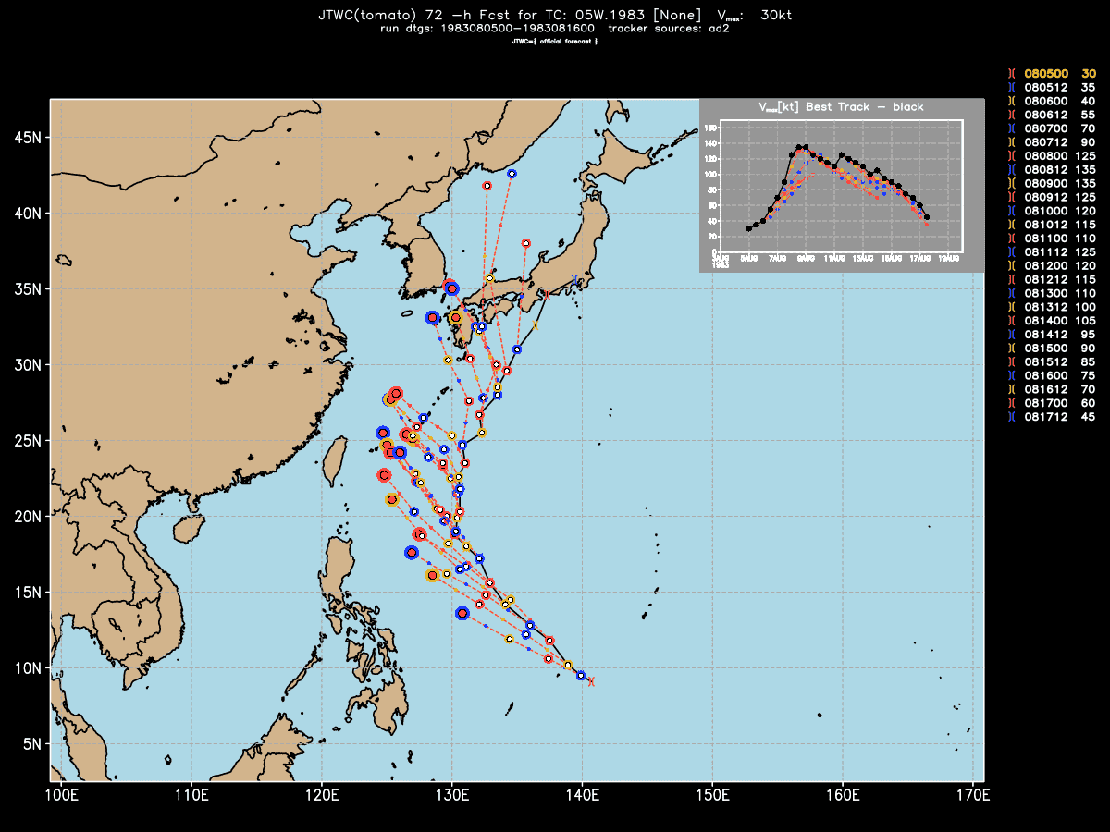
40th Anniversary of the 1984 TCC…STY Abby 05W.1983
TY & STY
080700-081612
9.5 d
JTWC
72-h forecasts
Notes:
where the fleet to go?
can’t ‘cross the T’

Slide 10
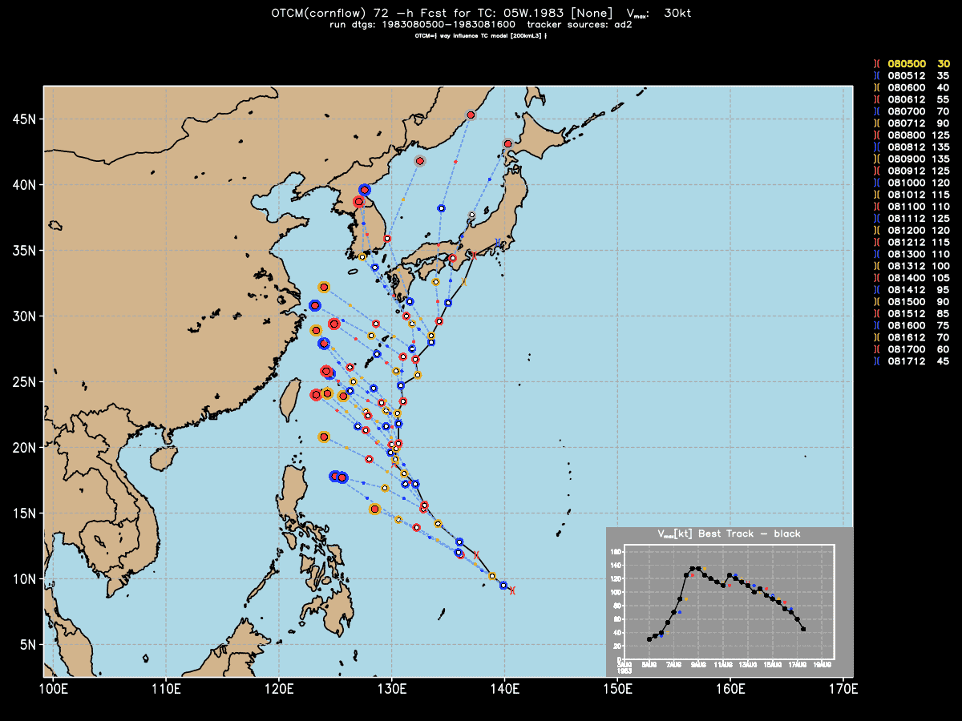
40th Anniversary of the 1984 TCC…STY Abby 05W.1983
OTCM
72-h forecasts
Notes:
JTOPS got tired of being beaten by the OTCM… call JTOPS if 72-h forecast position changes by more than 100 nmi (?)

Slide 11
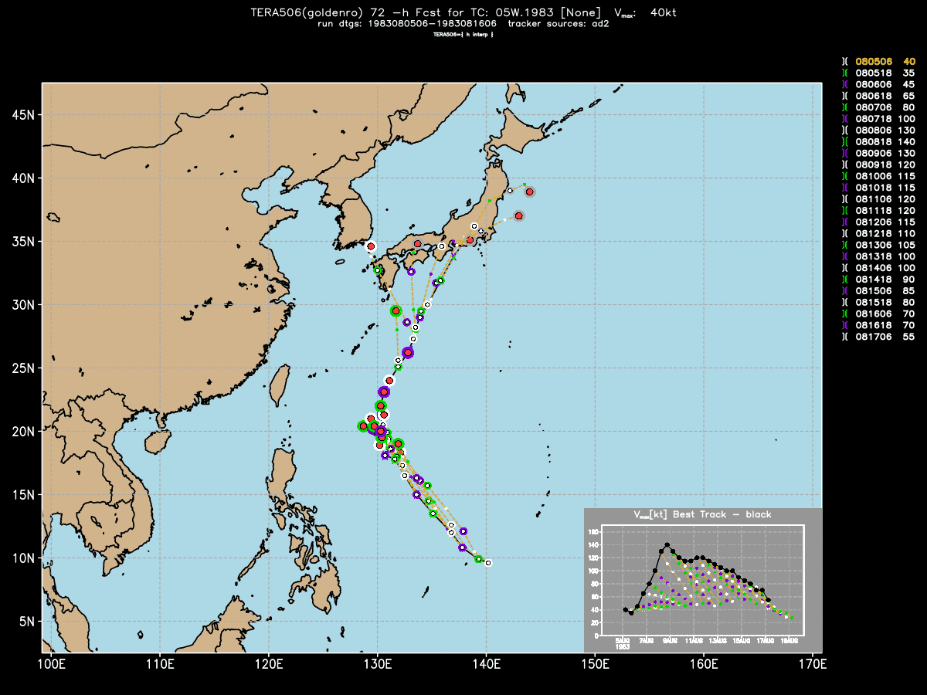
40th Anniversary of the 1984 TCC…STY Abby 05W.1983
ERA5
72-h forecasts
Notes:
no track bias mostly speed error

Slide 12
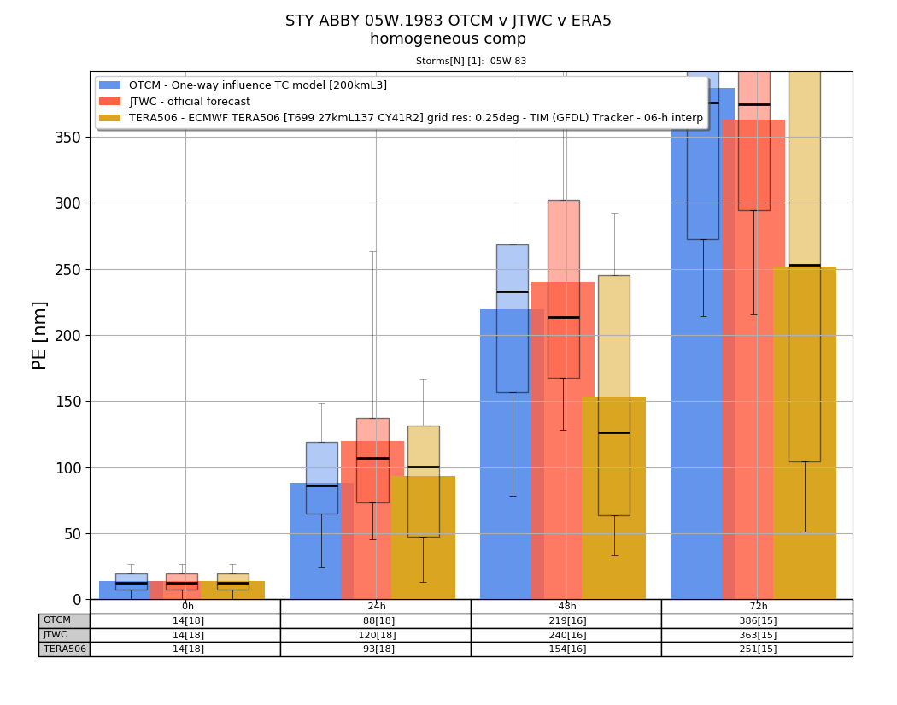
40th Anniversary of the 1984 TCC…STY Abby 05W.1983
72-h mean PE
JTWC: 363 nmi
OTCM: 386 nmi
ERA5: 251 nmi (mostly speed)
Notes:
363 nmi is ‘better’ than season mean of 425 nmi

Slide 13
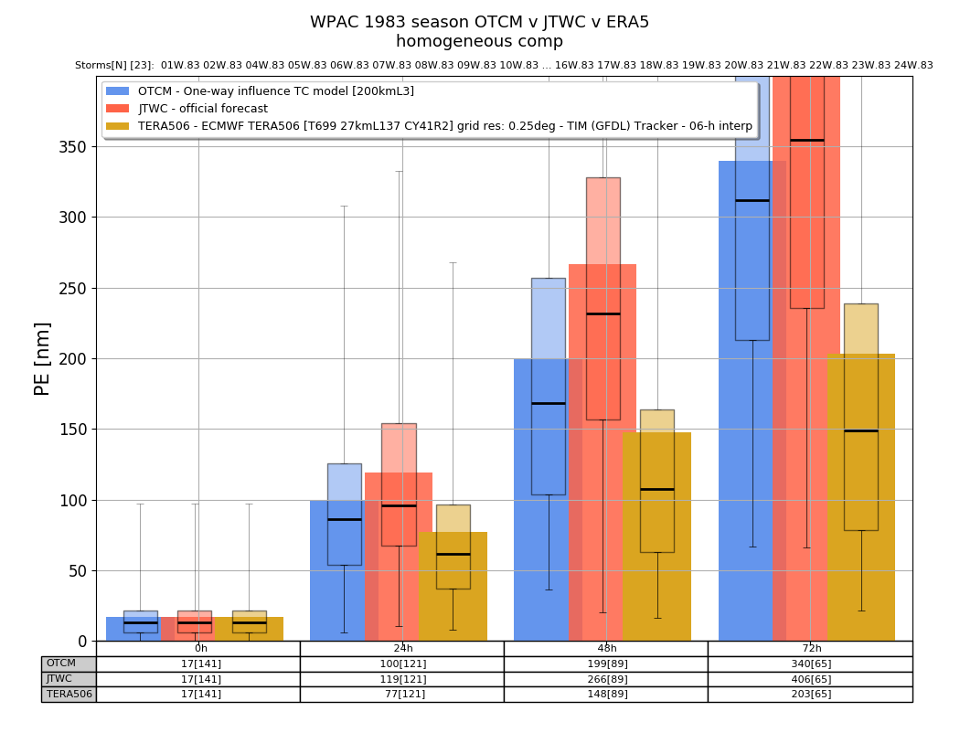
40th Anniversary of the 1984 TCC…STY Abby 05W.1983
WPAC 1983 Season
72-h mean PE
JTWC: 406 nmi
OTCM: 340 nmi
ERA5: 203 nmi

Slide 14
2024 TCC 40th Anniversary of the Momentous 1984 ATC because of STY ABBY 05W.1983 both personally (no stuff, there I was) and for USN
JTWC had a rough season, but the ABBY forecasts were typical of the era … 72-h mean PE ~ CLIPER ~ 380 nmi
The forecasts were not ‘bad’ in terms of mean PE …just huge impact on operations … gotta make better forecasts!
ERA5 forecasts were much better … using the same observing system of 1983 … because of the modeling (IMHO) … good source of dynamical information for an extended or super Best Track…

Slide 15


Validation of Operational pre-potential Tropical Cyclones (pTCs) Using the TC Diagnostic File
2016 …
pTCs & diagnostics file
Michael Natoli
University of Maryland, College Park
Michael Fiorino
Earth System Research Laboratory, Boulder, CO
21 April 2016

Slide 16
What’s a ‘superBT’? a partial theft from Krish’s ‘super ensemble’
superposition on to a TC best track data set of ancillary data from ERA5 (NWP – dynamics) and precipitation (thermodynamics)
three data set types:
‘mdeck’ – merge data from both adeck and bdeck for both NN and 9X
curated 9X 2006-2024 for both dev and non-dev
formation rate and time to formation/dissipation
genesis defined as first warning vice first TS (>= 35 kts)
ECMWF ERA5 reanalysis 00/12 UTC 10-d forecasts
three hi-res satellite global precipitation analyses
CMORPH (NCEP CPC)
GsMAP (Japan JAXA)
IMERG (NASA)
implementation – github project – V04 (1st beta)
2007-2022

Slide 17
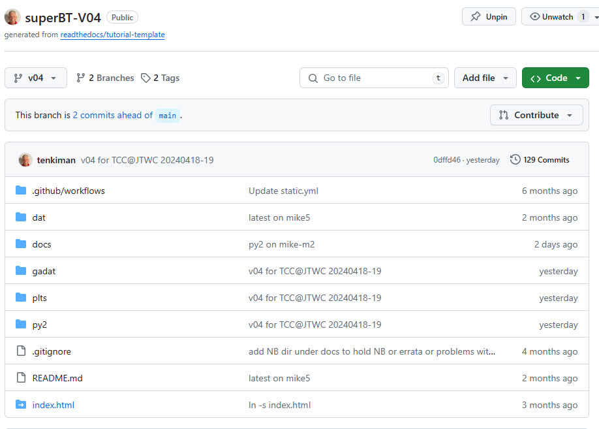
2024 …
https://github.com/tenkiman/superBT-V04
python(2) interface
list TC positions
Storm ID, e.g., -S w.07 (all WPAC TCs in 2007)
DTG range, e.g., all TCS from 2007090700-2007093000
comp 9Xdev v 9Xnon
list variables, e.g., VWS in .csv
21 April 2016

Slide 18
Topics
Quality of ERA5 forecasts – how good are the dynamics like vertical wind shear?
ABBY results suggest the analyses are ‘good’ and of consistent quality 1979-present
I have ERA5 forecasts for Halsey’s typhoon Cobra 19441215 – best track?
Formation or 9X → NN
rate or percentage of 9X that become NN
difference in dynamics (vertical wind shear) & thermo (3deg mean rain) between 9Xdev and 9Xnon
Version 1.0
add 2006 & 2023
add more R34 data from CIRA & ERA5

Slide 19
some words of wisdom…
“Forecasting is the acid test of an analysis”
Bob Kistler, NCEP
father of American Reanalysis
NCEP/NCAR R1

Slide 20
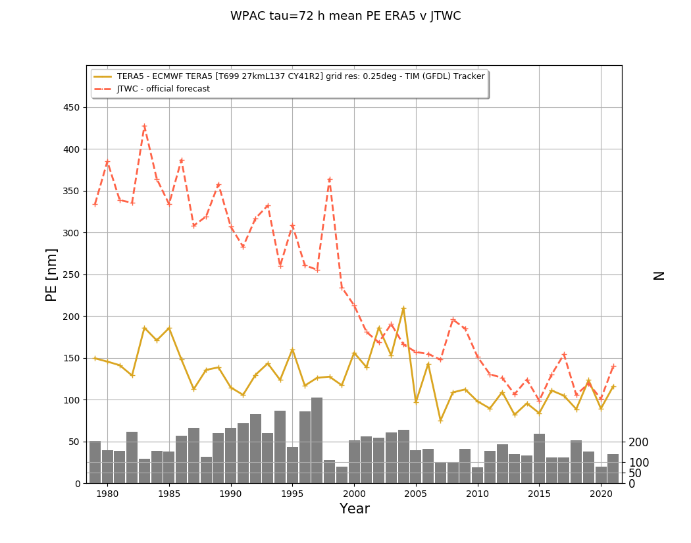
WPAC ERA5 v JTWC mean 72-h PE 1979-2021

Slide 21
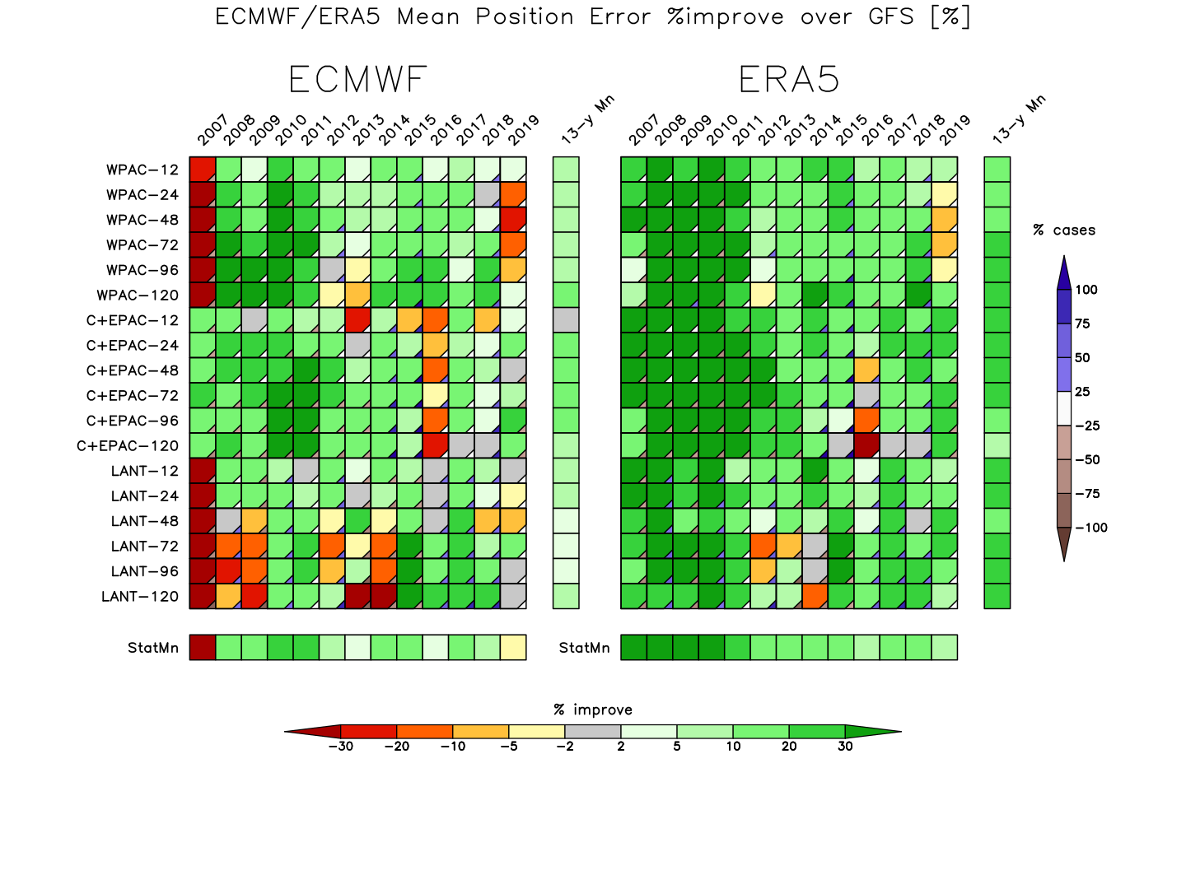
ECMWF v ERA5 v GFS 2007-2019 % improve (lower) mean PE relative to GFS as a baseline

Slide 22
Topics
Quality of ERA5 forecasts – how good is the dynamics like vertical wind shear?
ABBY results suggest the analyses are ‘good’ and of consistent quality 1979-present
Formation or 9X → NN
rate or percentage of 9X that become NN
difference in dynamics (vertical wind shear) & thermo (3deg mean rain) between 9Xdev and 9Xnon
Version 1.0
add 2006 & 2023
add more R34 data from CIRA & ERA5

Slide 23
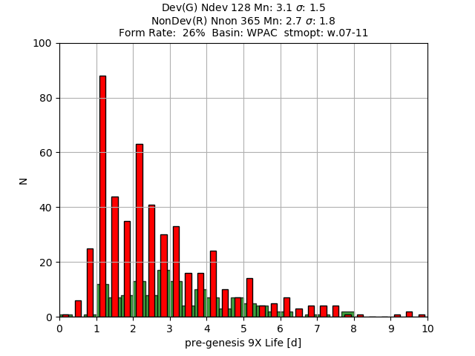
Formation Rate & Time to Genesis/Dissipation WPAC 2007-2011
Form Rate: 26%
(26% of all 9X become NN)
T-Gen: 3.1 d (9Xdev)
T-Diss: 2.7 d (9Xdev)

Slide 24
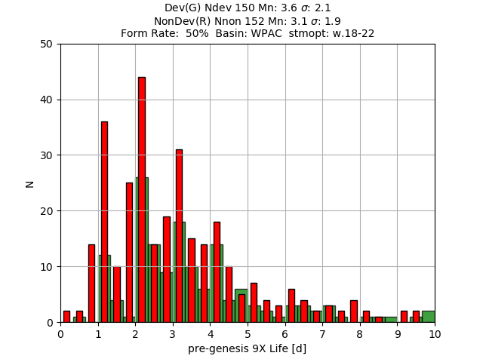
Formation Rate & Time to Genesis/Dissipation WPAC 2018-2022
Form Rate: 50%
(50% of all 9X become NN)
T-Gen: 3.6 d (9Xdev)
T-Diss: 3.1 d (9Xdev)

Slide 25
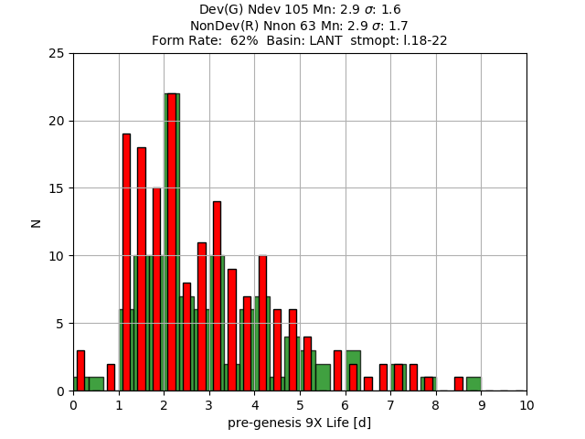
Formation Rate & Time to Genesis/Dissipation LANT 2018-2022
Form Rate: 62%
(62% of all 9X become NN)
T-Gen: 2.9 d (9Xdev)
T-Diss: 2.9 d (9Xdev)

Slide 26
Topics
Quality of ERA5 forecasts – how good is the dynamics like vertical wind shear?
ABBY results suggest the analyses are ‘good’ and of consistent quality 1979-present
Formation or 9X → NN
rate or percentage of 9X that become NN
difference in dynamics (vertical wind shear) & thermo (300 km mean rain) between 9Xdev and 9Xnon
Version 1.0
add 2006 & 2023
add more R34 data from CIRA & ERA5

Slide 27
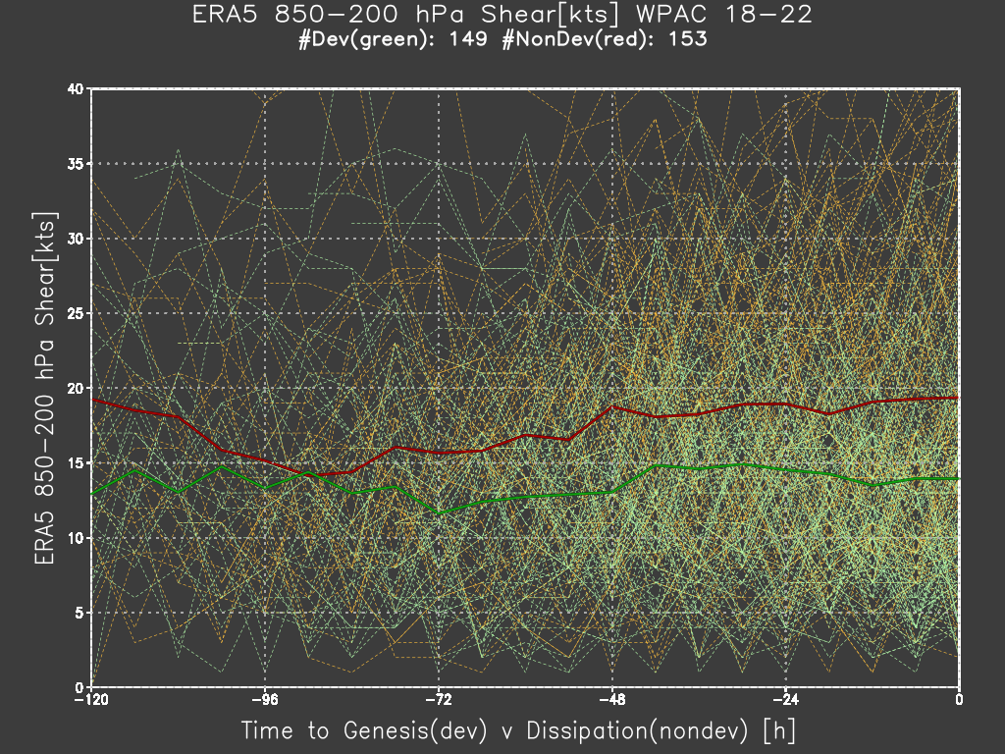
Vertical Wind Shear – diff between 9Xdev & 9Xnon WPAC 2018-2022
Red line – 9Xnon
Green line – 9Xdev
Xover ~ 84 h (3.4 d)
VWS ~ 15 kts
9Xnon ~ 19 kts
9Xdev ~ 15 kts

Slide 28
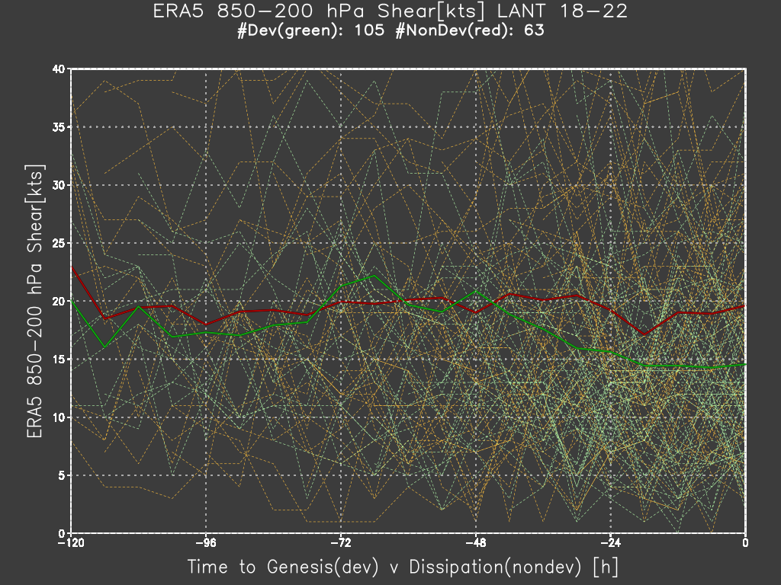
Vertical Wind Shear – diff between 9Xdev & 9Xnon LANT 2018-2022
Red line – 9Xnon
Green line – 9Xdev
Xover ~ 48 h (2.0 d)
VWS ~ 20 kts
9Xnon ~ 19 kts
9Xdev ~ 15 kts

Slide 29
Vertical Wind Shear – diff between 9Xdev & 9Xnon summary for 5-y period 2018-2022
WPAC
9Xdev v 9Xnon begin to depart or Xover point ~ 3 d
VWS ~ 15 kts & lower than in the LANT
both 9Xdev & 9Xnon start at 15 kts but 9Xnon increases to 19 kts
LANT
9Xdev v 9Xnon begin to depart or Xover point ~ 2 d
VWS ~ 20 kts & higher than in WPAC

Slide 30
Topics
Quality of ERA5 forecasts – how good is the dynamics like vertical wind shear?
ABBY results suggest the analyses are ‘good’ and of consistent quality 1979-present
Formation or 9X → NN
rate or percentage of 9X that become NN
difference in dynamics (vertical wind shear) & thermo (3deg mean rain) between 9Xdev and 9Xnon
Version 1.0
add 2006 & 2023
add more R34 data from CIRA & ERA5

Slide 31
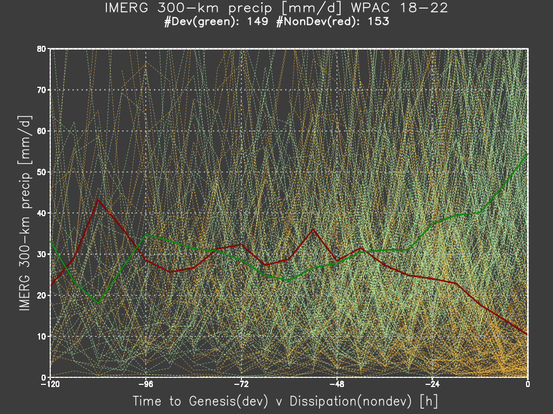
IMERG 300 km rainrate [mm/d] – diff between 9Xdev & 9Xnon WPAC 2018-2022
Red line – 9Xnon
Green line – 9Xdev
Xover ~ 48 h (2 d)
Rain ~ 30 mm/d
9Xdev
30 – 50 mm/d
9Xnon
30 - 10 mm/d

Slide 32
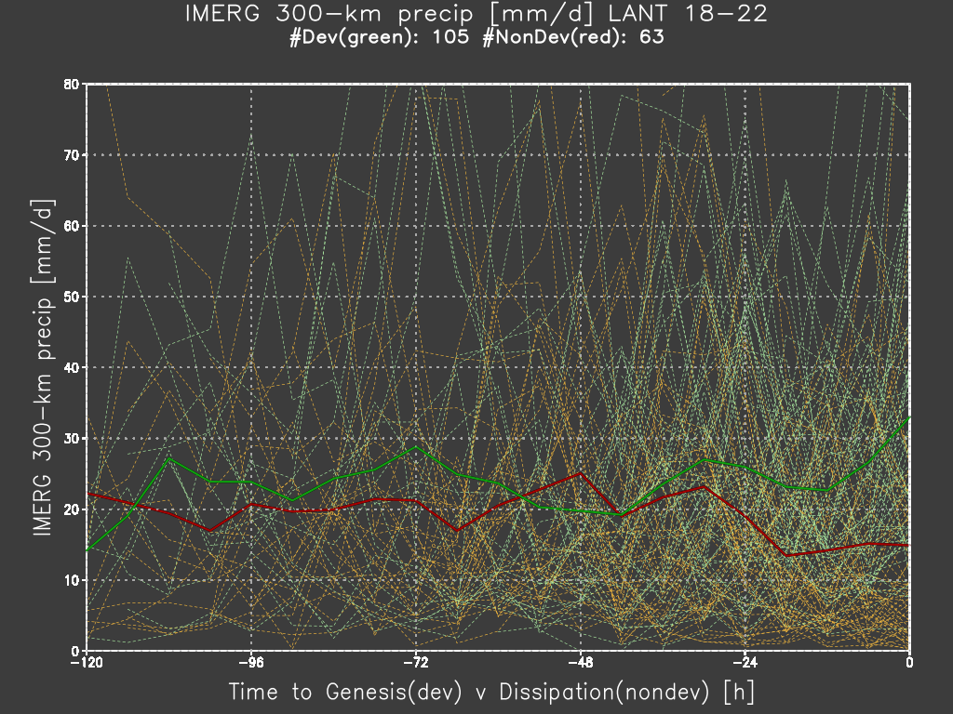
IMERG 300 km rainrate [mm/d] – diff between 9Xdev & 9Xnon LANT 2018-2022
Red line – 9Xnon
Green line – 9Xdev
Xover ~ 36 h (1.5 d)
Rain ~ 20 mm/d
9Xdev
20 – 30 mm/d
9Xnon
20 - 15 mm/d

Slide 33
IMERG 300 km rainrate [mm/d] – diff between 9Xdev & 9Xnon summary for 5 y period 2018-2022
WPAC
9Xdev v 9Xnon begin to depart or Xover point ~ 2 d
RR ~ 30 mm/d & higher than in the LANT
both 9Xdev & 9Xnon start at 30 mm/d but 9Xnon decreases to 15 mm/d
LANT
9Xdev v 9Xnon begin to depart or Xover point ~ 1.5 d
RR ~ 20 mm/d & lower than in WPAC
RR change ~ 10 mm/d vice 15-20 mm/d in WPAC

Slide 34
Summary – 9Xdev v 9Xnon
Formation Rate or 9X → NN
substantial increase in JTWC/WPAC 2007 – 2022
9X is no-cost to the TDO
current TDO/HS at both JTWC & NHC are more consistent in identifying ‘significant’ disturbances
highest formation rate is in EPAC lowest in SHEM
VWS
higher in the LANT (~20 kts); lower in WPAC (~15 kts)
Xover point longer in WPAC (3.5 d) v LANT (2.0 d)
Rain
WPAC higher (~30 mm/d) v LANT (~20 mm/d)
Xover point longer in WPAC (2.0 d) v LANT (1.5 d)

Slide 35
Takeaways and an answer to Bill Gray’s Question …
the superBT adds three unique and high-quality data sets to existing Best Tracks
1979-2024 – ERA5 2X daily 10-d forecasts
1999-2024 – NASA IMERG hi-res, nearly-global precipitation
2006-2024 – curated 9Xdev & 9Xnon
Shown unique differences in both VWS and rain rate between 9Xdev and 9Xnon
V04 at https://github.com/tenkiman/superBT-V04/
V1.0 – add TC size – my bigger interest
2006 & 2023 (from 17 y to 19 y)
R34 from best track + CIRA + R34/POCI from ECMWF IFS & ERA5

Slide 36
Links
URL | Data/Doc/Web
https://github.com/tenkiman/superBT-V04 | V04 github repo and starting README
https://github.com/tenkiman/superBT-V04/releases/tag/V04.01 | 1st release as .zip or tar.gz files
https://github.com/tenkiman/superBT-V04/blob/main/docs/README-sbt-v04.md | detailed README of the 1st github
https://surperbt.blogspot.com/2023/12/intro-to-superbt.html | superBT blog with introduction to the superBT and results
https://maps.wxmap2.com/ | WxMAP2 originally developed at JTWC 2002-2005
https://jtdiag.wxmap2.com/ | JTDIAG to display ‘diagnostic file’ for real-time forecasting
https://tcgen.wxmap2.com/ | TC genesis

Slide 37
Mahalo どうも ありがとう ございました

